Slide 1
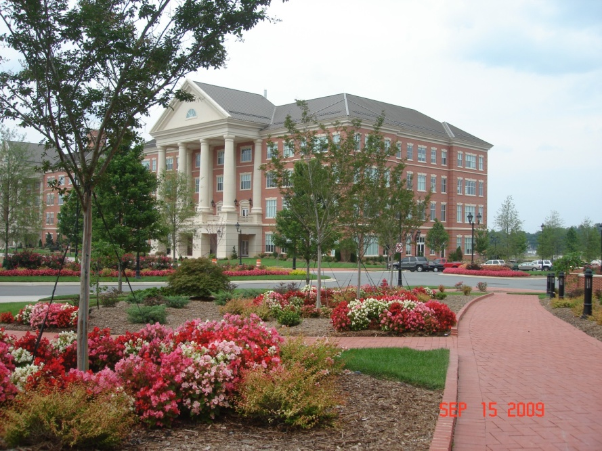
Proper Cooling Matters: Shelf life and Fruit Quality
Dr. Penelope Perkins, Horticulture, NCSU
Plants for Human Health Institute
Kannapolis NC

Slide 2
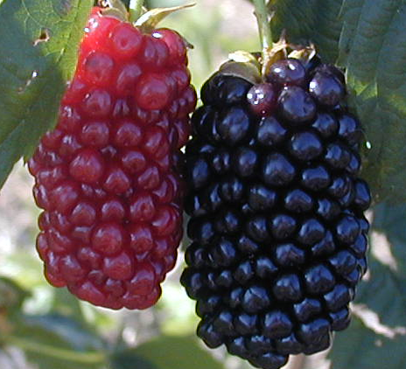
Always remember:
Berries are still alive after harvest
They may decay, but the mitochondria that respires
takes a long time to die!

Slide 3
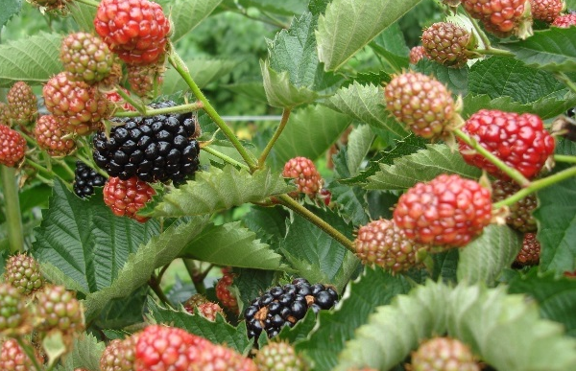
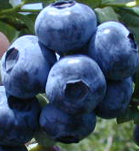

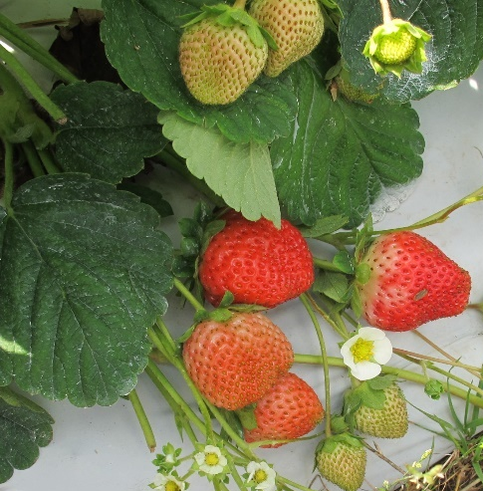

Berries
$≠$ Apples
Thin cuticle
Finger size
Must be almost to fully ripe
Must pick into final container
Usually no washing
Rapid cooling and cold chain critical
Usually no mechanical sorting
Consumers eat without washing
Notes:
The purpose of these slides is to show how small fruits stand apart from other fruits. Not large like apple or cantaloupe, not much protection from a peel (even muscadine), generally more of a soft texture than crisp (although that is changing), most often picked in final container.

Slide 4
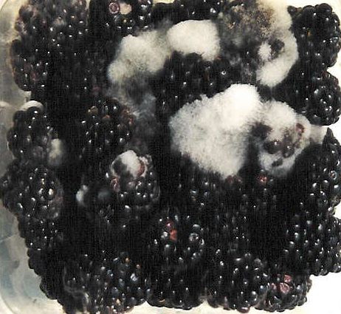
Berries
These attributes lead to:
Ease of bruising during picking or transport
Higher respiration
More weight loss
Rapid mold growth and decay (Botrytis or gray mold)

Slide 5
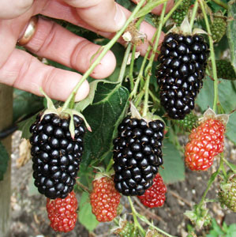
What steps will minimize losses?
Variety or cultivar: breeding for firmer fruit and/or resistance to decay is an ongoing process
In blackberries, better shelf life varieties include Von, Navaho, Arapaho, Ouachita, APF 45, Traveler, Natchez, Osage

Slide 6
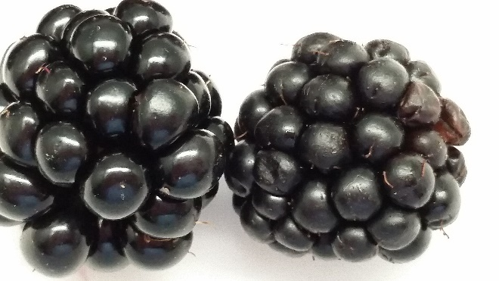
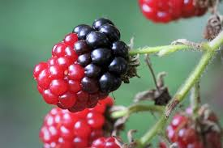
Harvest ripe, but not too ripe
Fully ripe, shiny, well filled, firm
Starting to get soft-see the druplet, Starting to wrinkle
Too unripe-won’t get full
Black color or soften right

Slide 7
Harvest before noon
Get berries out of the field before the air gets to 80 F
Berries on east side warm up faster between 6 and noon but there is more build up of heat on the west side of the row after noon
Warm berries create more heat from the heat of respiration, also have more heat to remove in cooling

Slide 8
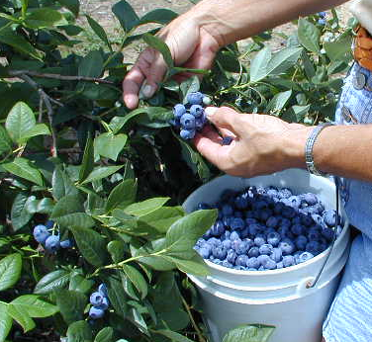
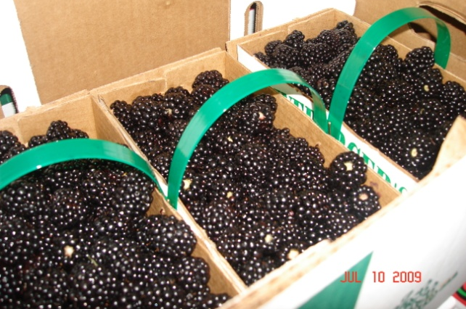
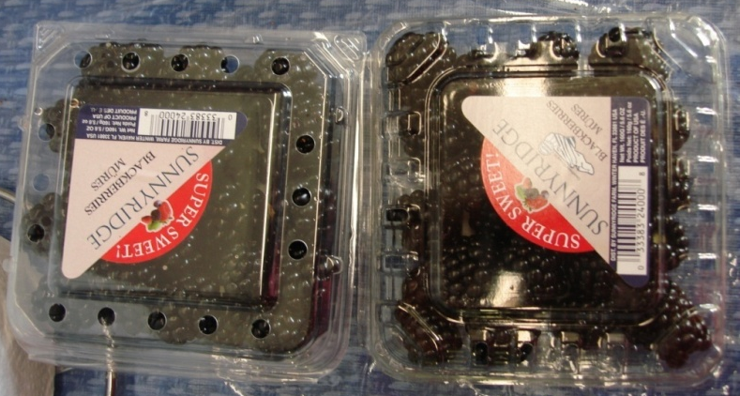
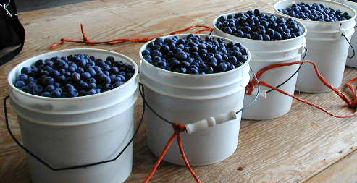
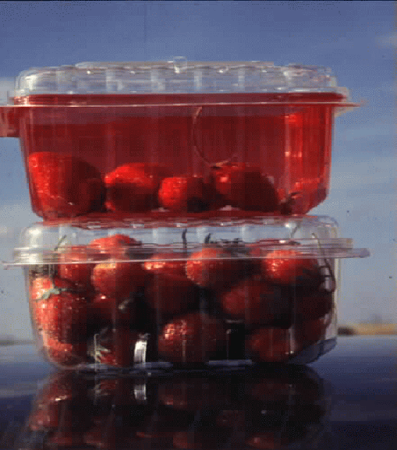
Other harvest and handling tips
Avoid diseased or injured berries
Pick when cool and dry
Handle fruit only once
Pack in appropriate containers
Cool quickly after harvest
Notes:
Characteristics of muscadine grapes:
slip skin (rolls in mouth)
seeds (large, not easy to ignore)
clusters of 3-9 berries rather than hanging like bunch grapes
Clusters are on top of vine, often under foliage

Slide 9
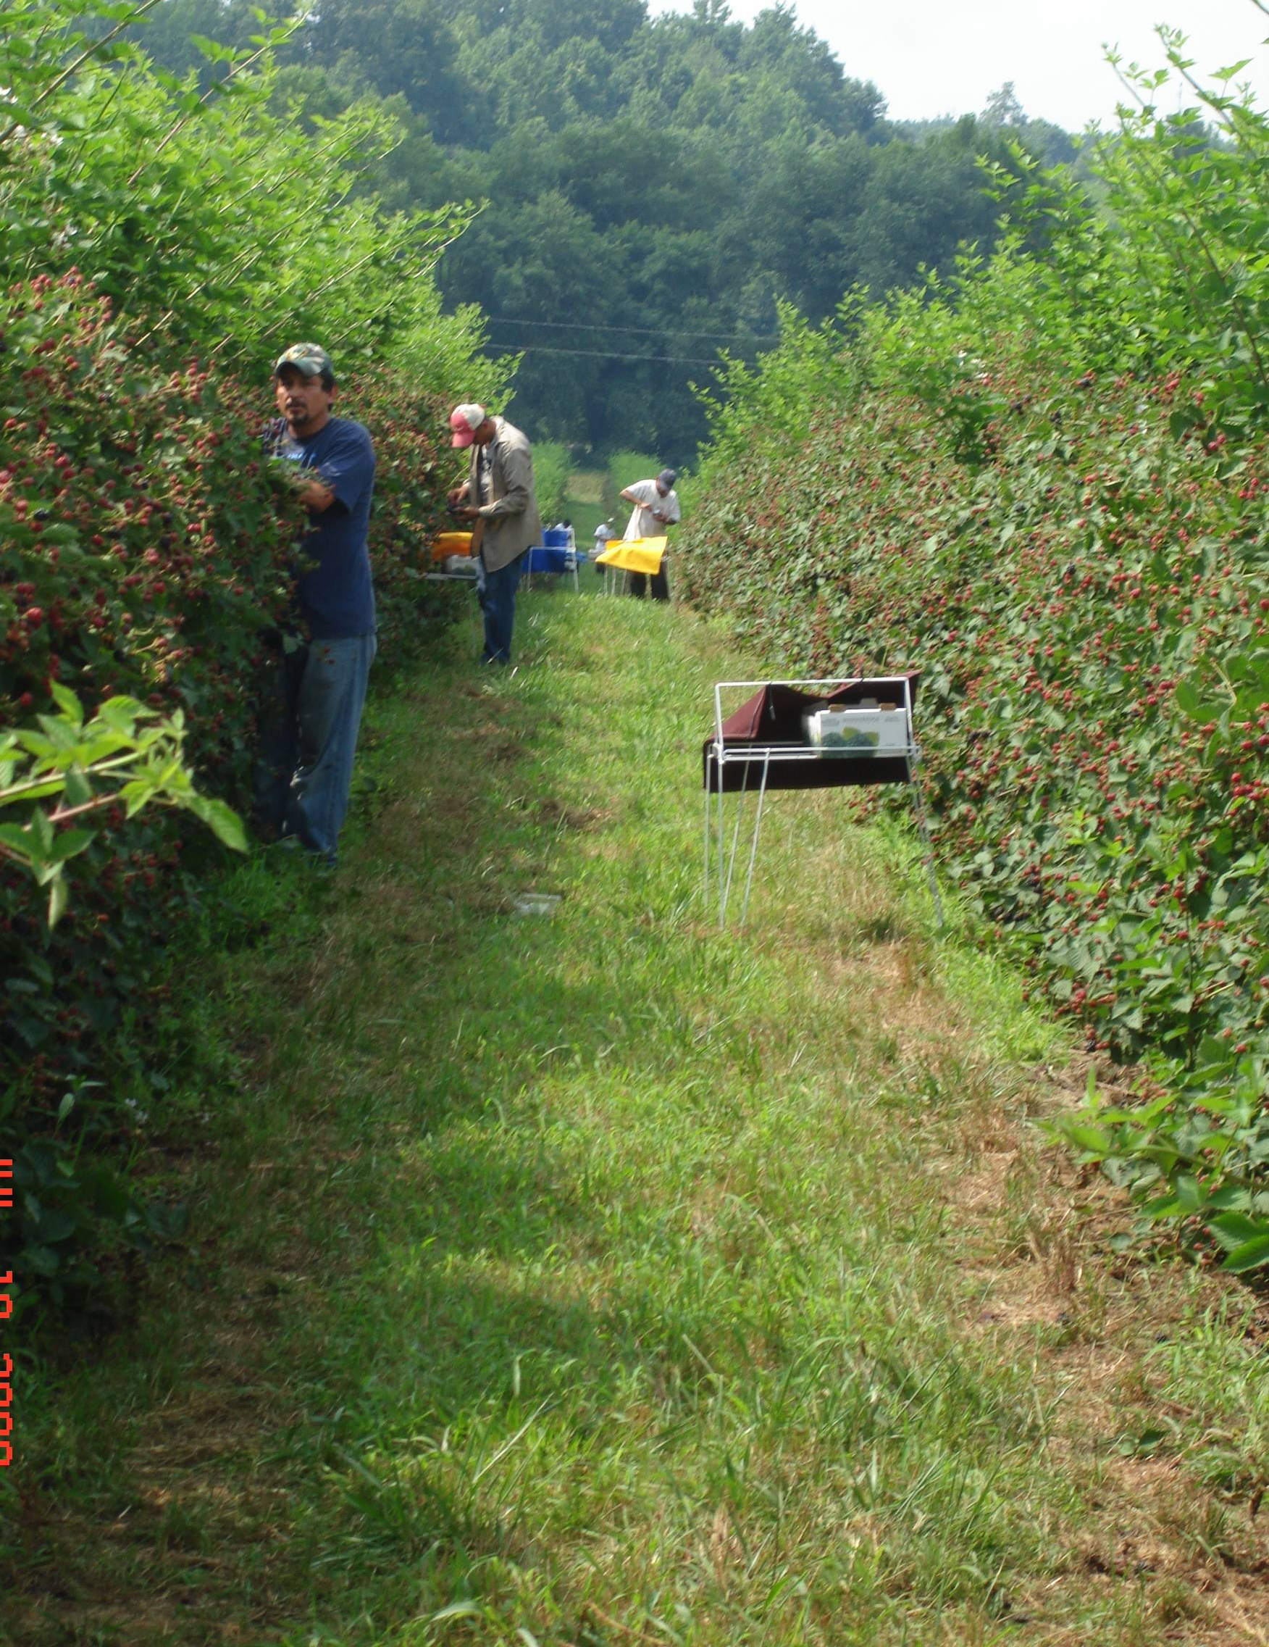
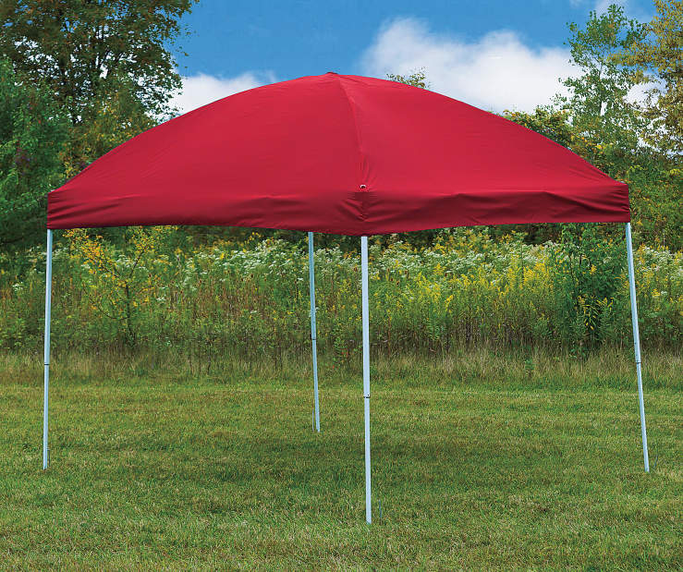
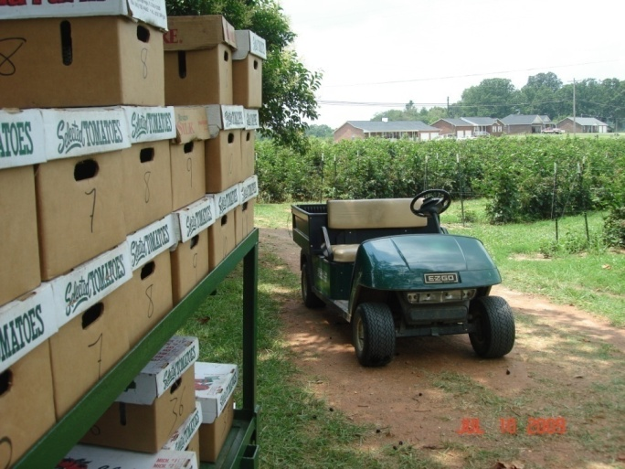
Minimize Heat Build up
Harvest when cool (before noon or at night)
Keep fruit in shade
Take fruit to coolers frequently
Notes:
USE OF WATER TO COOL, SUCH AS HYDROCOOLING, ICE, NOT USED IN SMALL FRUITS ALTHOUGH CAN HELP REMOVE SOME FIELD HEAT IF WASHING MUSCADINE, BLUEBERRY

Slide 10

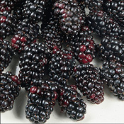
Other problems
Red drupe or color reversion Seen only after blackberries are cooled and stored
seems to result from combinations of softer berries, delayed cooling and/or uneven temperature distribution in forced air systems, possibly excess nitrogen

Slide 11
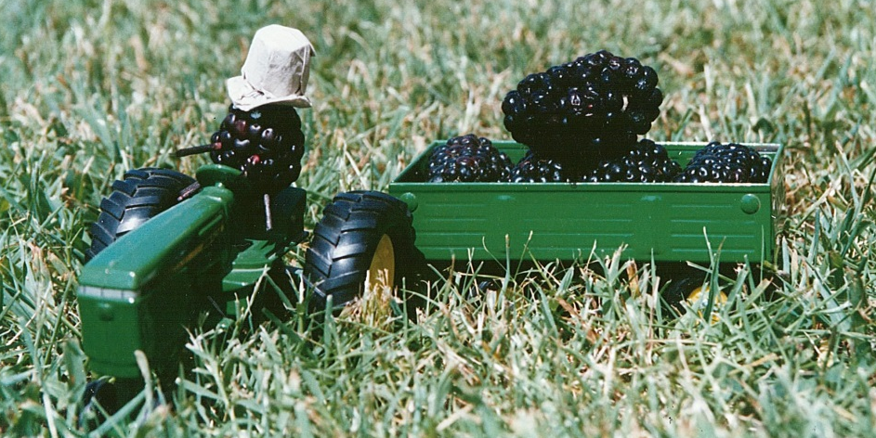
Berries
Only a few choices for cooling and storage
Blackberry shelf life is 5-21 days
After the first 2 hours, shelf life is reduced 20% by every hour of delayed cooling

Slide 12
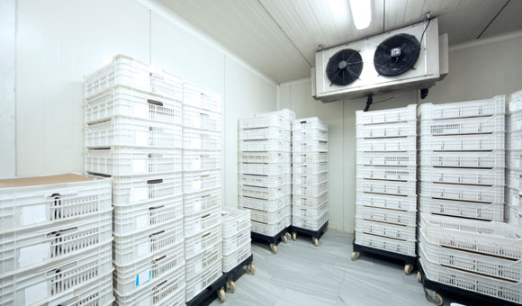
Cooling Steps
Fruit brought into pack house
Placed in cold room until ready for forced air cooling
Moved into cold room once forced air done
Most small fruits will not freeze if kept below 32°F
Often temperatures of 33-38°F are used to avoid freezing
If using 41°F, shelf life will be around 5-7 days

Slide 13
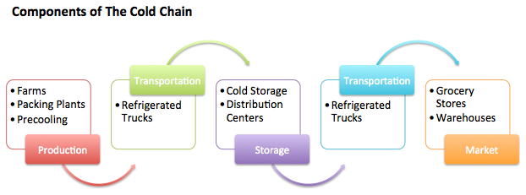
The Cold Room Chain
Maintain cooling and coldness from field to consumer
-Remove field heat
-Keep coldness in fruit
-Avoid rewarming
Keeping berries cold can triple shelf life
Notes:
USE OF WATER TO COOL, SUCH AS HYDROCOOLING, ICE, NOT USED IN SMALL FRUITS ALTHOUGH CAN HELP REMOVE SOME FIELD HEAT IF WASHING MUSCADINE, BLUEBERRY

Slide 14
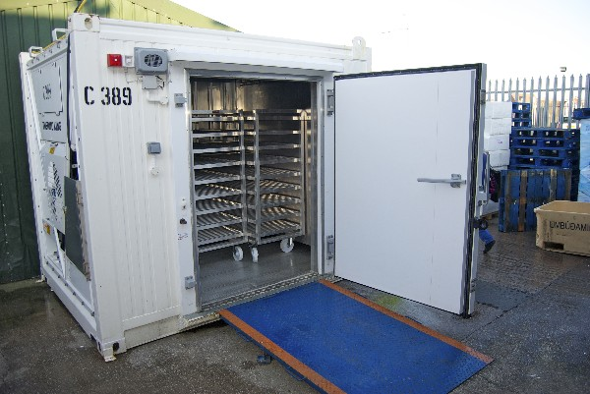
Needs for Cold Rooms
Must be well insulated, especially doors/ceilings
Have refrigeration capacity for expected heat load and volume
Placed under in shade to keep down cooling load
Leave in room for stacking and moving pallets

Slide 15
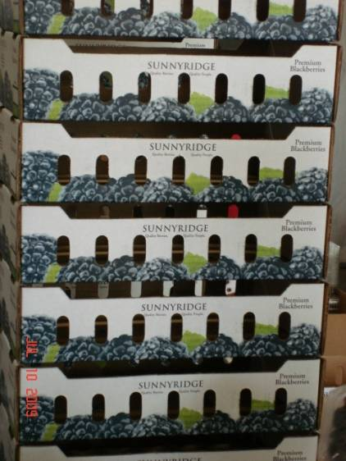
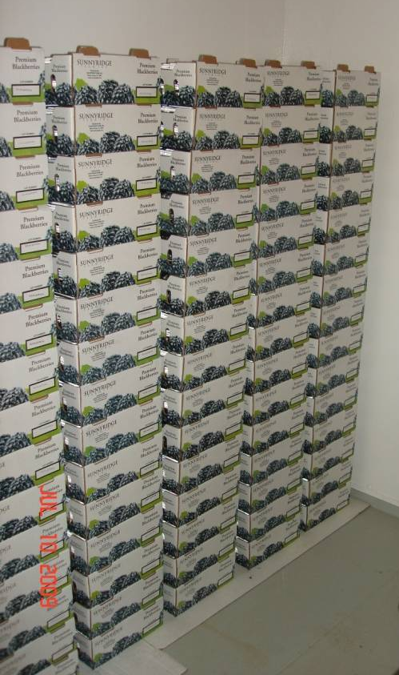
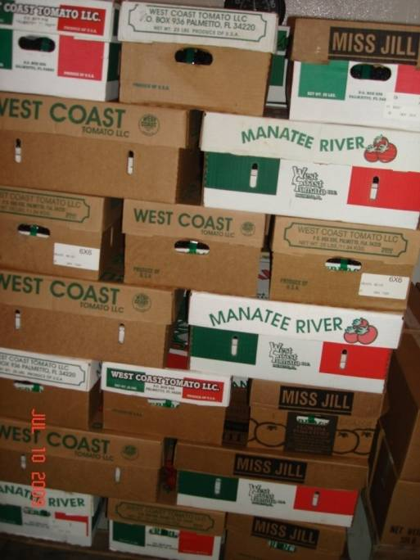
Room Cooling
Vents in master for air flow within carton
Allow Air Movement Between Boxes And Flats

Slide 16
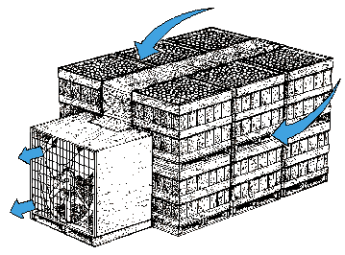
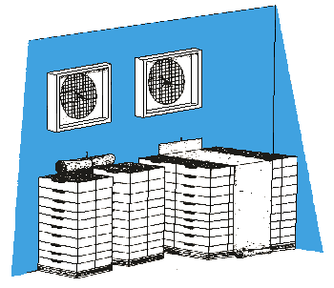
Forced-air Cooling (Tunnel)
Forces cold air through directed paths in boxed fruit
Can be field portable
Room portable
Built-in
Notes:
FA ROOMS WORK BEST IF INSIDE A COLD ROOM

Slide 17
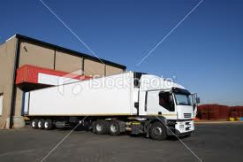
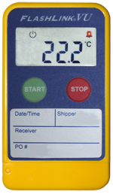

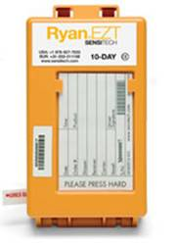
After Cooling
Load into refrigerated transit quickly
Unload cold product into refrigerated storage quickly
Monitor temperature during transit using recorders
Warming fruit to room temperature after cooling will cut shelf life in half

Slide 18
Cold rooms and cooling for small loads

Slide 19
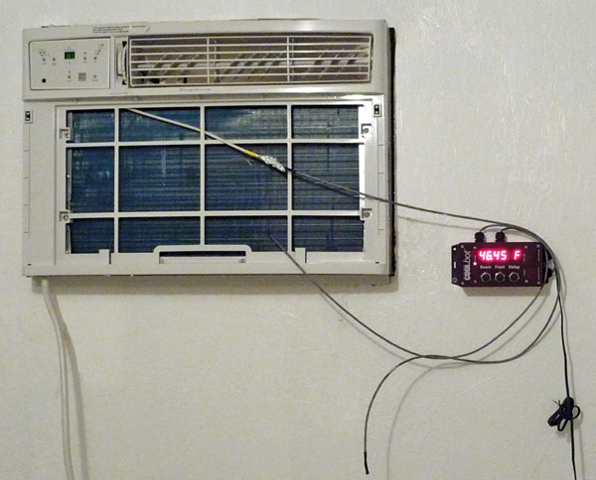
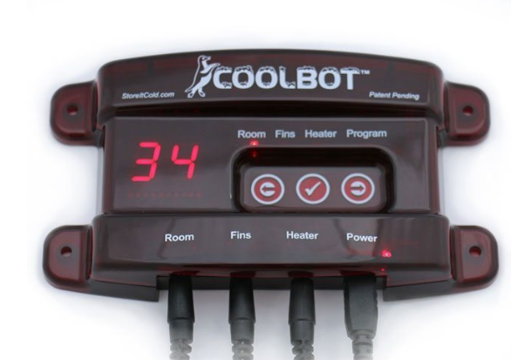
COOL BOT
AC UNITS:
10,000 TO 25,000 BTU ($300-600)
NOT ALL BRANDS WORK-CHECK THE WEBSITE!
http://www.storeitcold.com
Use this system to make an inexpensive cold room or for
portable cooling ($349 for cool bot)

Slide 20
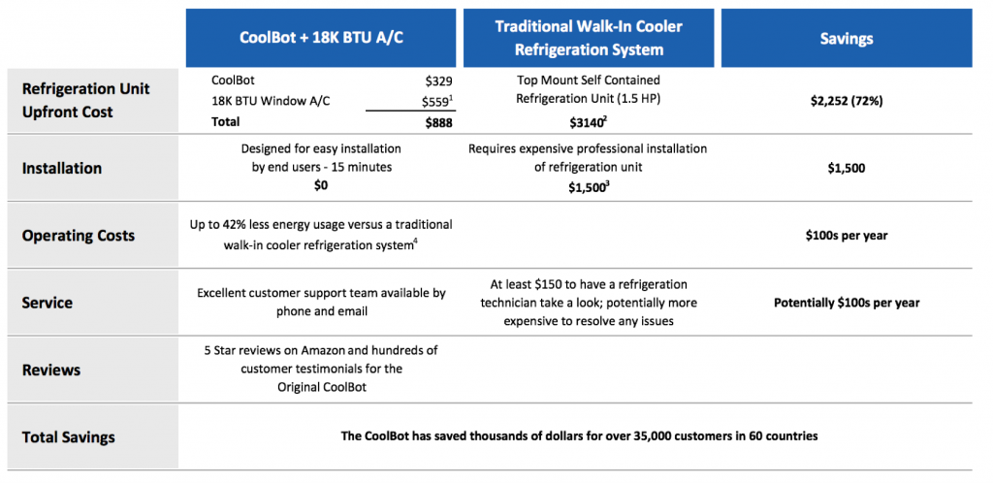
Key: often energy costs are lower
if the AC unit stops working, is simple and quick to get a new one, reinstall
Most common complaint: defrost cycle triggered (build up of ice), have to manipulate the sensor and the differential, see troubleshooting or can call storeitcold for help

Slide 21
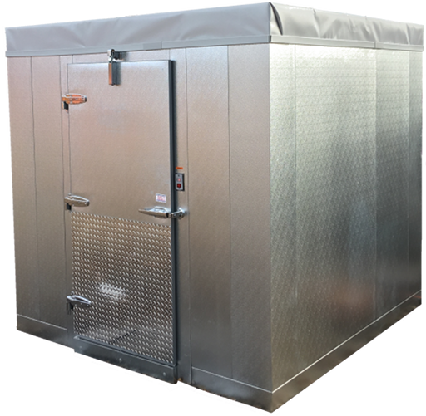
Free standing cold room
https://www.storeitcold.com/coolbot-walk-in-cooler/
Better to keep under a roof for protection from rain or inside a large room
Cost for 8x8 is $5,000 without floor
$5700 with floor, plus freight charges

Slide 22
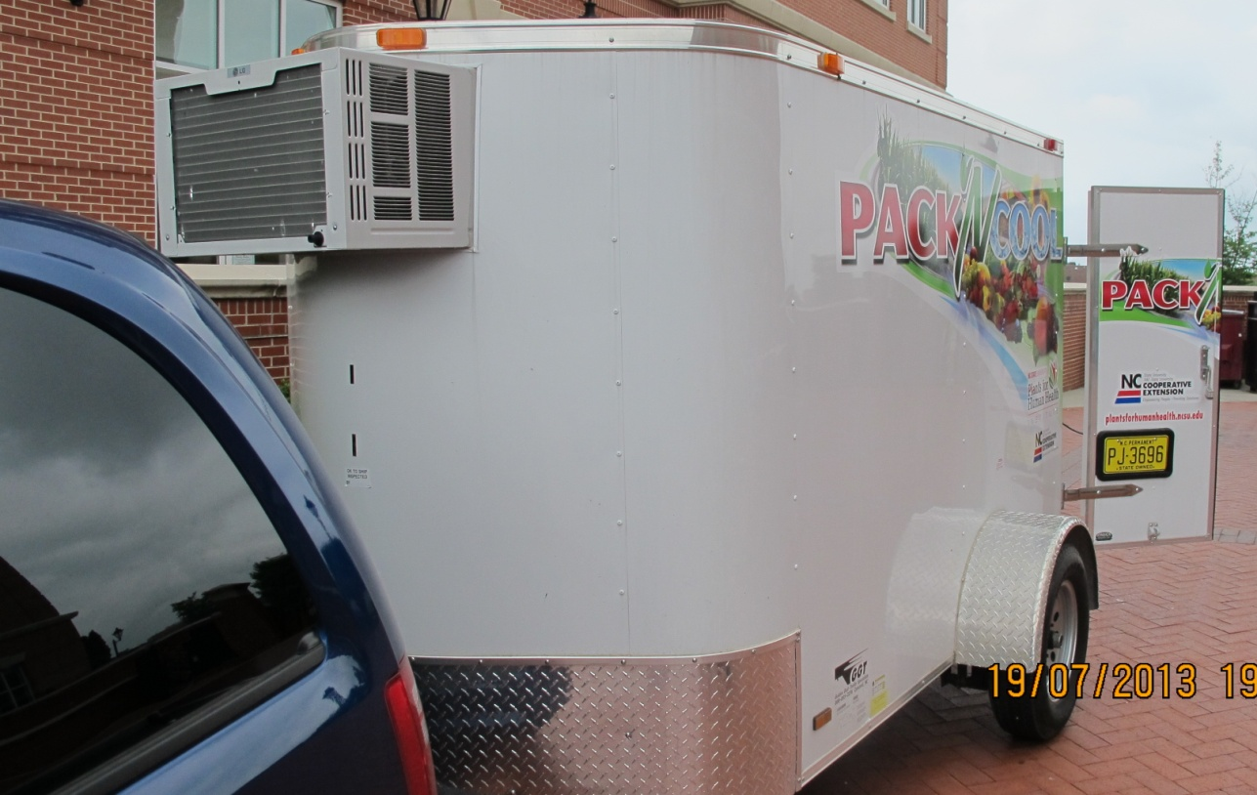
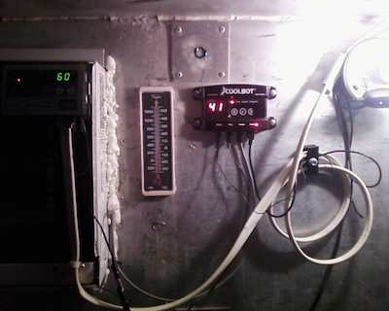
NCSU Pack N Cool Trailer
For cooling at picking site
Or for precooling and cooling at direct sales

Slide 23
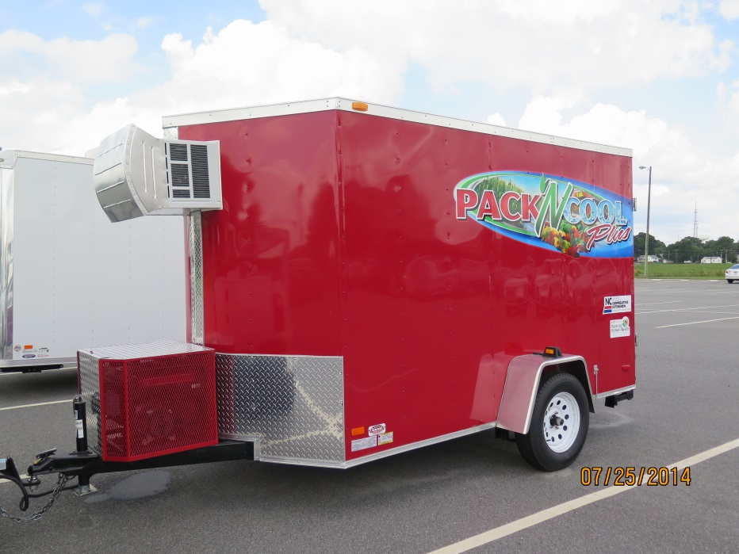
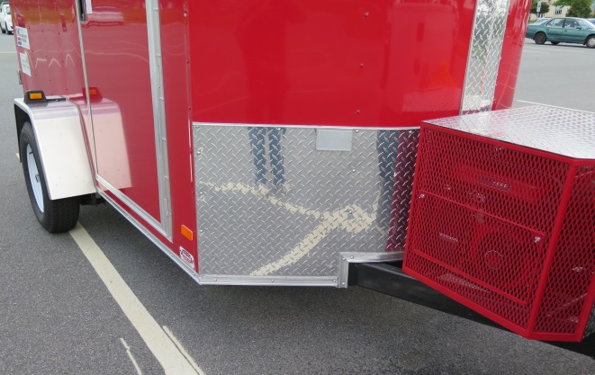
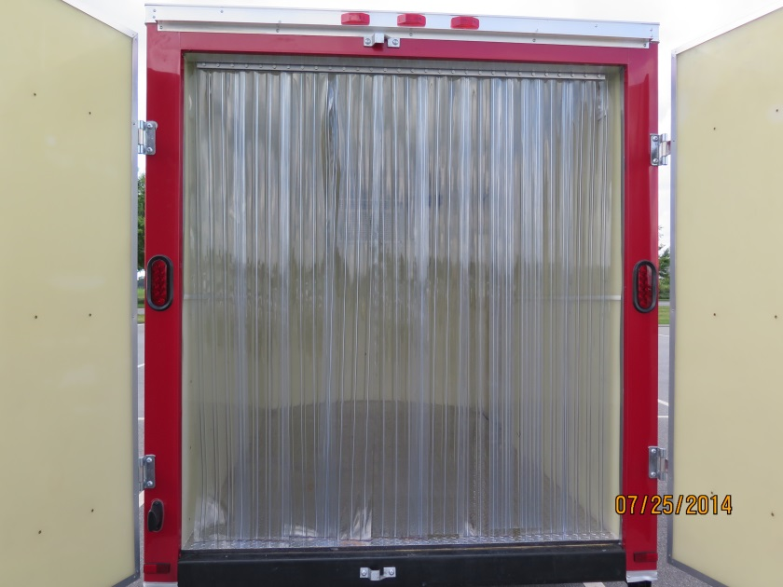
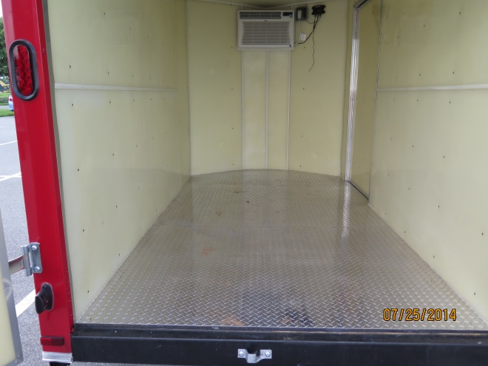
Generator and cover
Diamond plate floor
Hdpe walls
AC unit
Plastic curtain (global industries)

Slide 24
What are the limits?
Temperature: really won’t function well at a temperature below 37 F
DYI: Getting the walls and floors in shape for repeated cleanings
Can use diamond plate flooring to protect
Food grade panels help but must keep substances from getting in cracks, screw holes

Slide 25
Model outside to see, also sheets on construction
Also available at https://plantsforhumanhealth.ncsu.edu/2012/08/20/pack-n-cool/
Note: keep in mind what your purpose is. Certain operations will require food grade materials, cleaning protocols, which will affect your choice of plastic or wood walls, or flooring
Suggest: add the curtain-it’s cheap, slows cold air loss, entry of bugs, and diamond plate flooring as it’s easier to keep clean and protects the floor. Add the longer tongue on the trailer and a higher height (6 feet)

Slide 26
Other construction hints
Make sure insulation is both top and bottom of trailer and if there is an overhead opening, consider insulating over this.
Insulation can be placed under the trailer floor (soil side) to gain needed height inside the trailer.
Deflector or nosecone on the AC unit in the front helps protect it from debris going down the road. These need to be made with a special tool used at auto training schools.

Slide 27
American Trailers of the carolinas
Has a location in Cleveland, NC (Rowan County)
Offers prebuilt and customized trailers
Various sizes (5x8, 6x10 etc) with different systems: cool bot, other refrigeration systems
Can find more on blog on storeitcold.com (June 2019)
Call: 704-326-5049 or John Helms at 704-202-6676

Slide 28
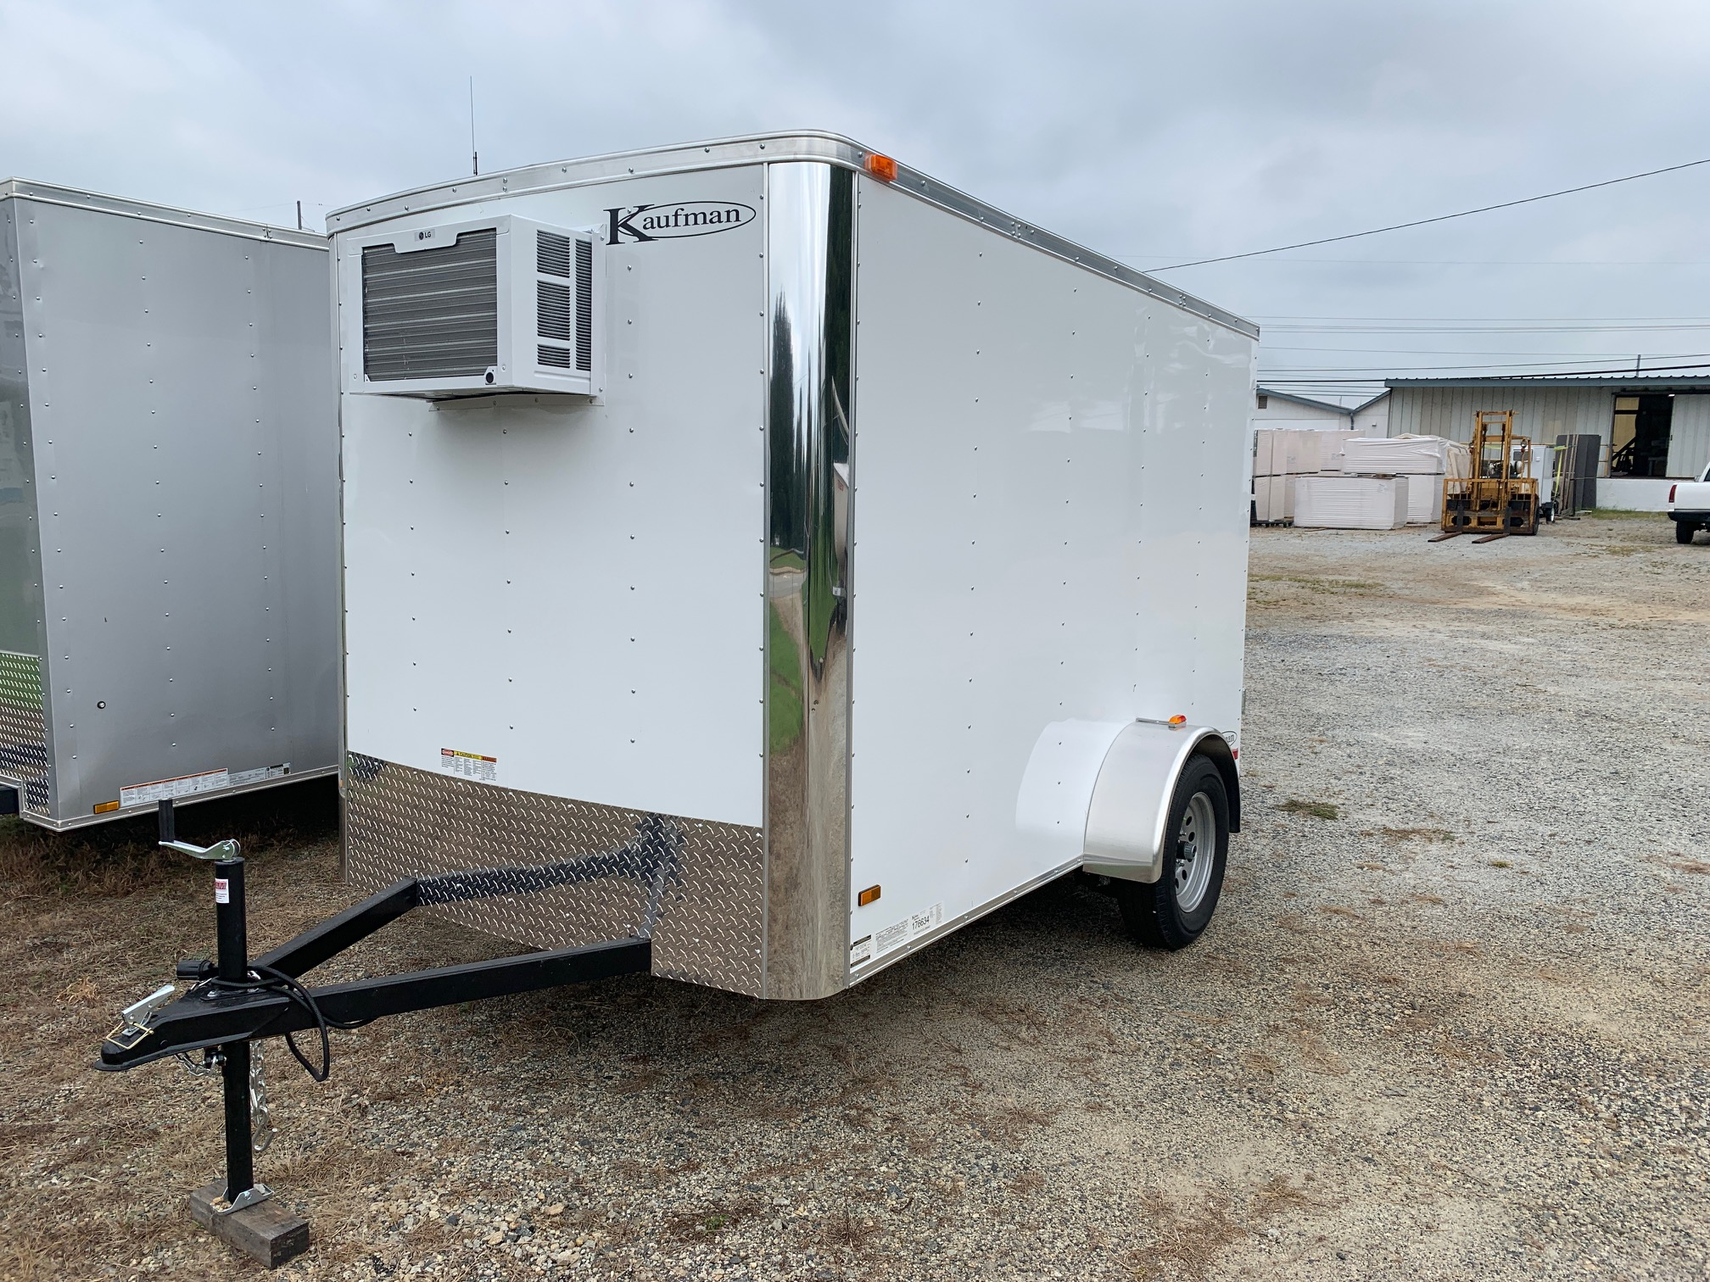
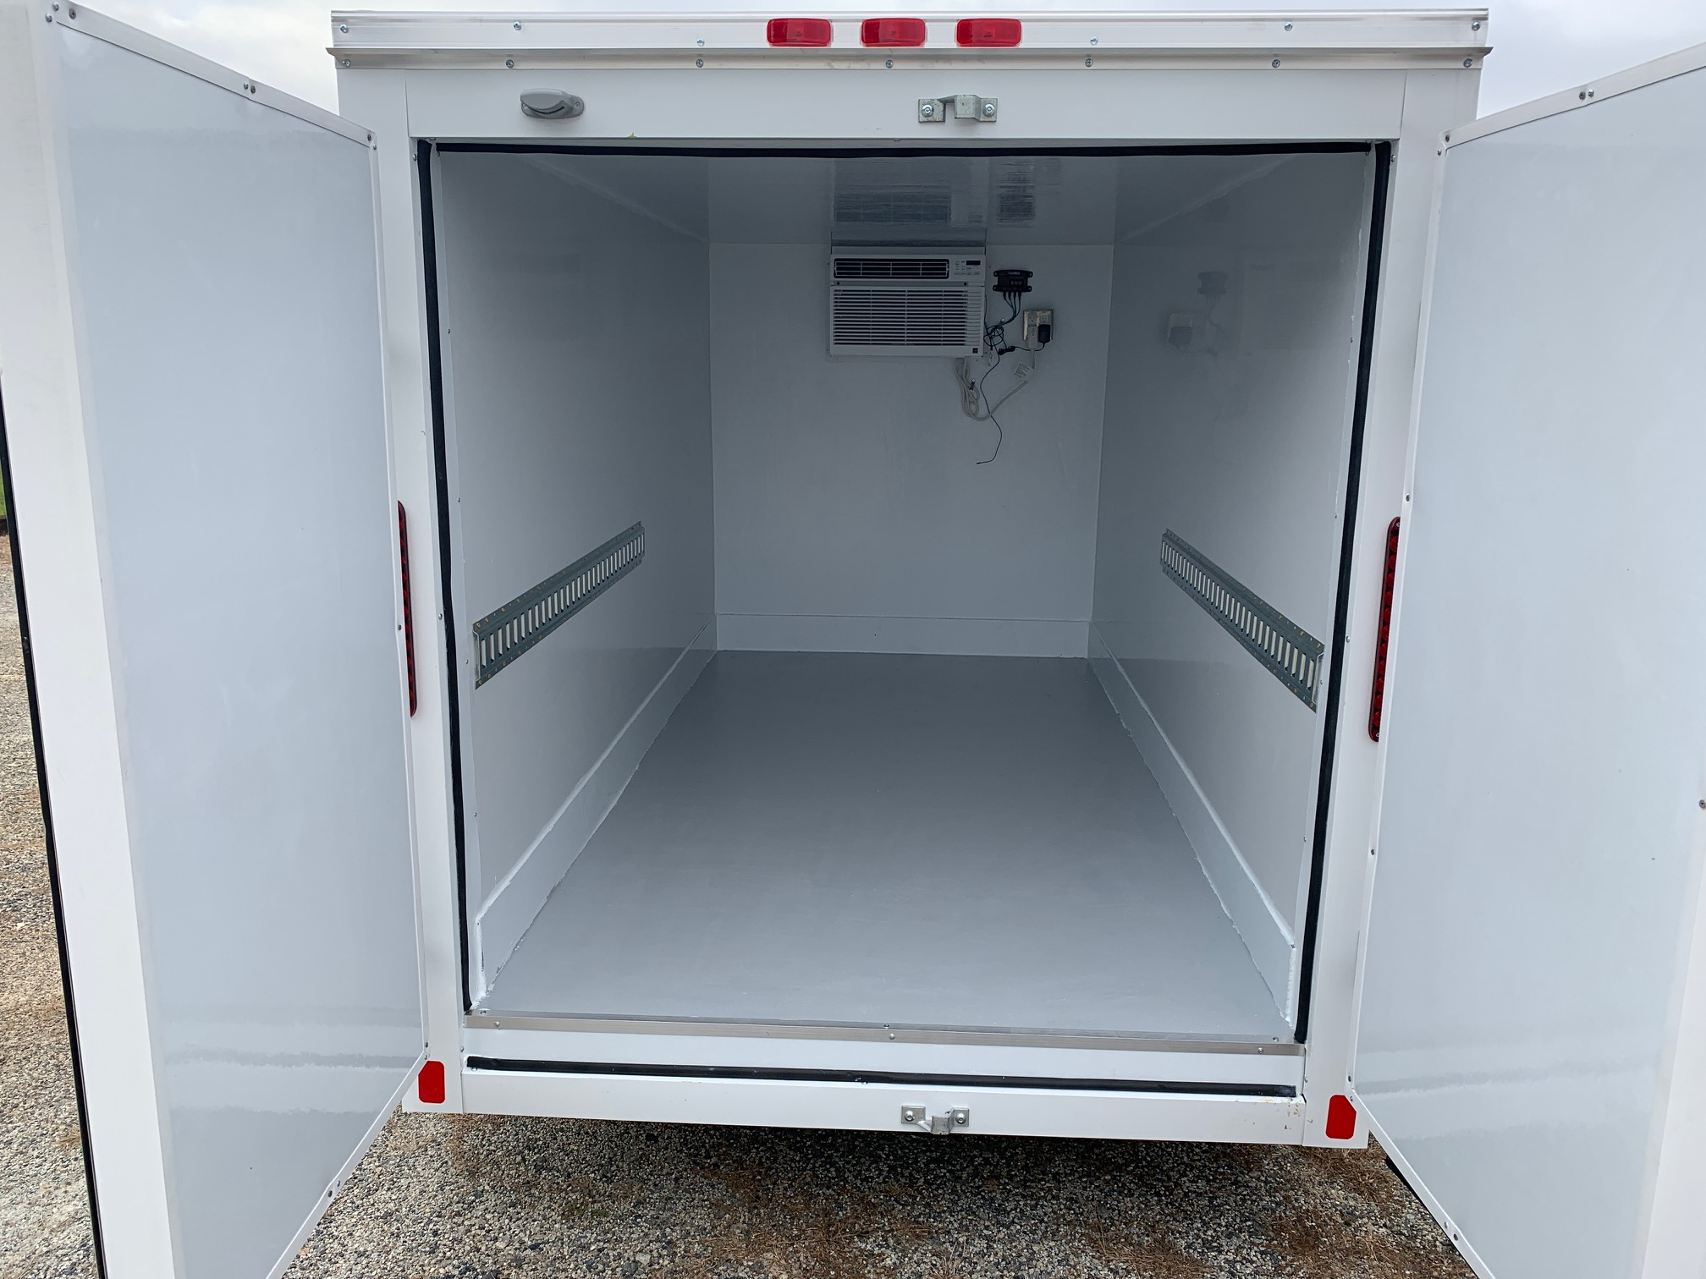
johnwhelms@gmail.com
Have food grade panels, easier to clean, also other styles of refrigeration to get under 37 F

Slide 29
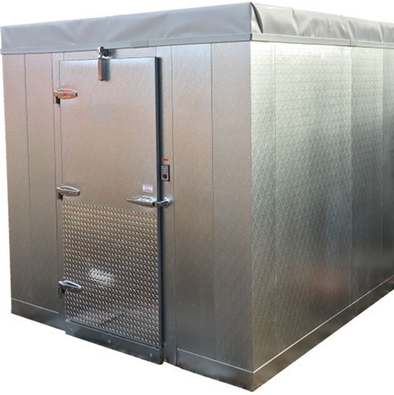
Resources
USDA-FSA (Farm Service Agency): makes loans and microloans for cooling, cold trucks. See: https://www.fsa.usda.gov/programs-and-services/price-support/facility-loans/farm-storage/
Storeitcold. https://www.fsa.usda.gov/programs-and-services/price-support/facility-loans/farm-storage/com Will sell premade walk-in coolers that use the cool bot technology
See: https://www.storeitcold.com/coolbot-walk-in-cooler/
Mobile coolers/trailers: see storeitcold.com for videos from growers, also check out
https://plantsforhumanhealth.ncsu.edu/2012/08/20/pack-n-cool/

Slide 30
Sources of information
https://www.bae.ncsu.edu/programs/extension/publicat/postharv/
https://www.ncgrowingtogether.org/for-producers/
http://rvpadmin.cce.cornell.edu/uploads/doc_101.pdf
(small forced air cooler)
http://www.storeitcold.com/ (cool bot, lots of posts on diy and postharvest)
https://hilo.hawaii.edu/academics/cafnrm/research/documents/Alowcosthydro-coolerforvegetables.pdf small hydrocooler

Slide 31
UNIV CALIFORNIA-DAVIS AND UC-KEARNEYSVILLE http://postharvest.ucdavis.edu/
postharvest.ucdavis.edu/Pubs/publications.shtml
Postharvest Technology of Horticultural Crops publication 3311 (UC-Davis) 2002
  Postharvest Technology for Small-Scale Produce Marketers: Economic Opportunities, Quality and Food Safety
USDA HANDBOOK 66 http://www.ba.ars.usda.gov/hb66/contents.html
USDA Grading Standards https://www.ams.usda.gov/grades-standards

